Slide 1
SRE Personal Use-Case - Gagandeep Singh & Amresh Krishnamurthy

Slide 2
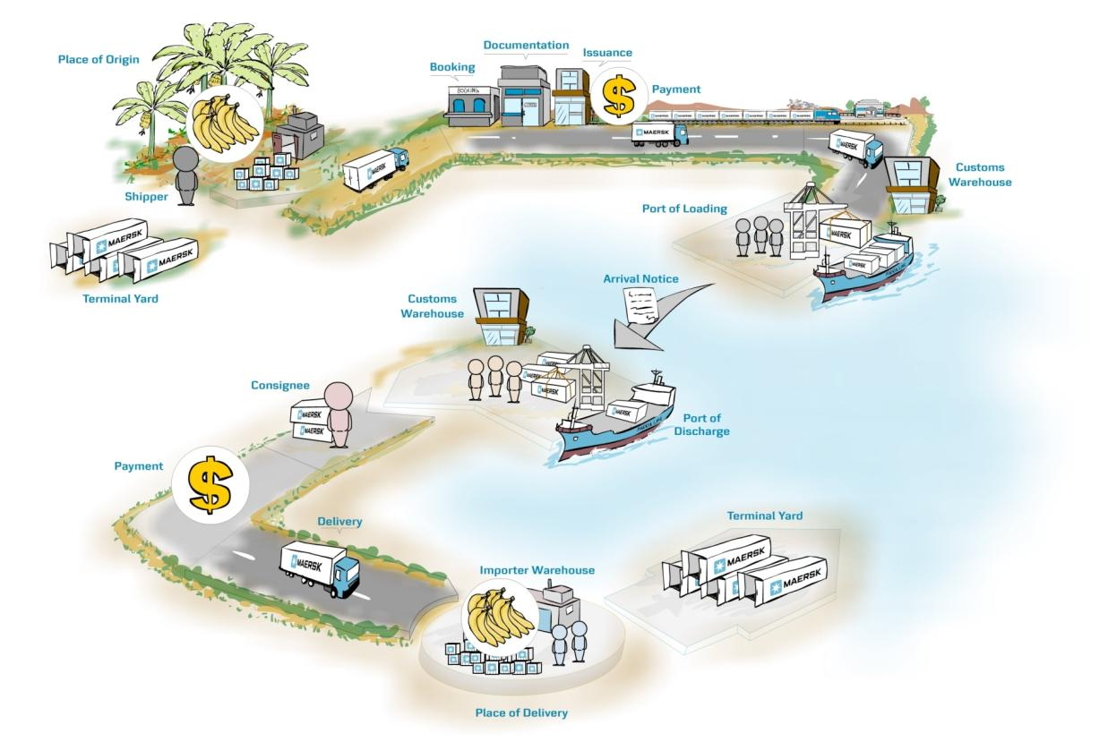
Where in the customer’s journey do we fit in?

Slide 3
Current Deployment-Process & Problem Statement
Service landscape
Problems Observed
Critical services are integrated with Maersk.COM customer Journey
Peak Volume of 70K TPH
Event driven architecture
Intermittent Request Failures during deployment
No defined roll-back strategy in place
Non-Peak deployments / Weekend Deployments/ Low confidence

Slide 4
Solution – Implement Blue/Green Deployment Strategy
What is - Blue/Green Strategy
Initial Stage – Prod service and prod deployment available in the blue slot. Service selector points to blue
Svc
host: prod
Ing
Service : Prod , Slot Blue
Deployments
Svc
host: stage
Service : Stage , Slot Green

Slide 5
Deploy updated version of the application in the green slot
Ensure the version is rightly deployed and working as expected
Svc
host: prod
Ing
Service : Prod , Slot Blue
Deployments
Svc
host: stage
Service : Stage , Slot Green

Slide 6
Update the service selector (prod) to point to the green slot and stage service to point to the blue slot
Reverse the slot from the next deployment , like active becomes green and updated version gets in blue
Svc
host: prod
Ing
Service : Prod , Slot Green
Deployments
Svc
host: stage
Service : Stage , Slot Blue

Slide 7
Demo and Learning & Next-Steps
Release Pipeline
Helm package manager constraints
Need a working model to implement the plan in production
CI/CD pipeline updates
Implementing Kubernetes liveness and readiness probes rightly

